Slide 1
Lite Lite™
Lighting Weeaboos
Calvin Trinh Madison Koelzer
Cody Mangham Simon Ngo
Eldon Hayes Nathan Van

Slide 2
Problem Statement
The current Hue app does not meet expectations for Lighting Designers
Limited customization of settings
Lacks ability to create intricate scenes
UI is clunky and doesn’t flow

Slide 3
Design Versus Original Scenario
Access to Two new Modes: Designer and User mode rather than having one mode on the Stock Hue App
Made a smoother UI
Lamp color changing is more customizable with added customizable RGB and Hex Values

Slide 4

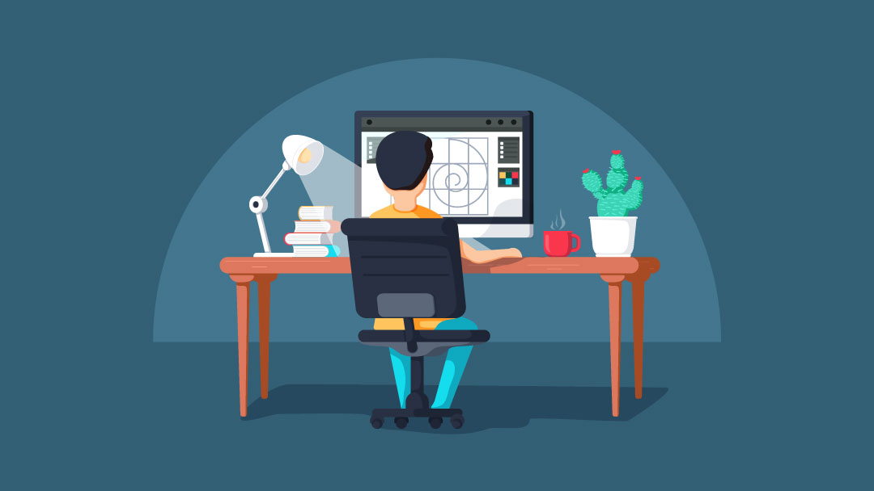
Design Philosophy
Simplicity vs Powerful Customization
User-Mode vs Designer-Mode

Slide 5
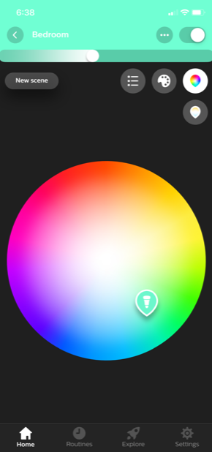
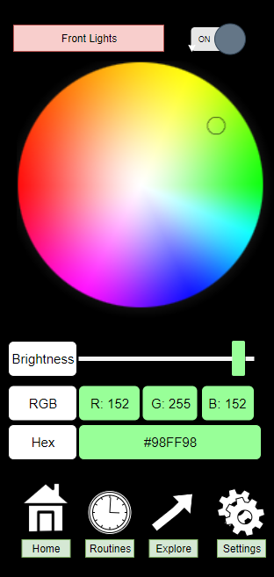
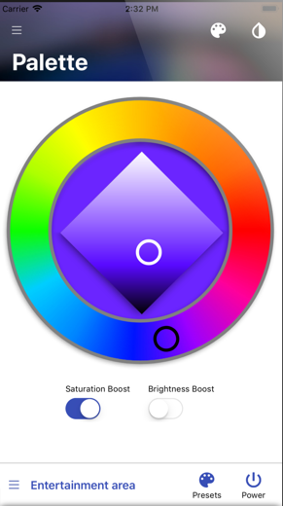
Design versus Other Hue Apps
Stock Hue Lite Lite hueDynamic

Slide 6
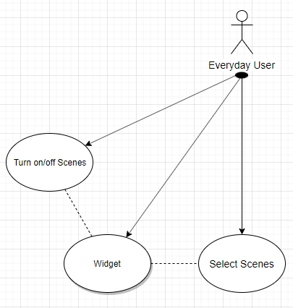
User Mode
App Usage
Scene selection from list
Add/Remove scenes from list
Routines
quick switch to Designer Mode
Widget
Quick Access to turning on/off Scene
Default setting
3-most recently accessed scenes

Slide 7
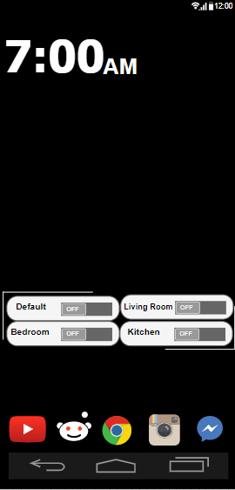
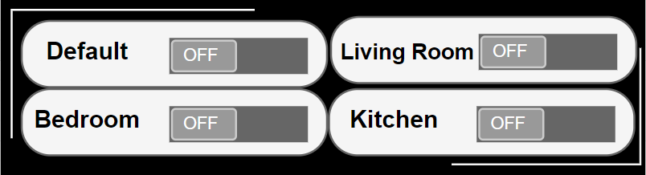
User Wireframe
Widget

Slide 8
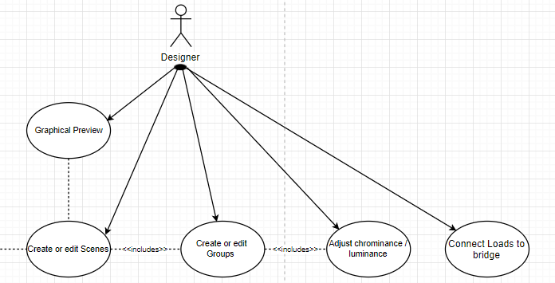
Designer Mode
Access to change settings:
Graphical Preview
Assign Loads to Groups
Assign Groups to Scenes
Modify SceneGroupSettings

Slide 9
Future of Lite Lite
Implementation of Profiles
Sound Integration (like clapping)
Temperature Compatibility
Security Patches
Notes:
Conclusion: Thank you Nathan and Madison for the in depth look into the designer mode part of our app, Lite Lite.
As was referenced back in our Design Philosophy with Cody, we went into our app with a focus on two things: customization and addressing the clunkiness contained within most other lighting apps, as examined by Calvin. While we can’t show off simplicity as a key selling point within the app itself, we tried to make it as intuitive and smooth as possible when compared to other apps.
Beyond that, we asked ourselves, why tunnel so hard on simplicity within the main app when we can do what we can and focus on that elsewhere. As Simon showed us all, we decided that elsewhere to be our widget. Our widget gives a much quicker and more convenient way of turning on and off all the lights as well as the 3 most recently accessed scenes. With the convenience of our app, we were allowed to be more open minded as to what we did within the user and designer mode parts of the app.
Our graphical preview feature is a perfect exemplification of this. While it may seem a bit excessive and maybe unnecessary, user input on it reacted very positively on its inclusion which is why we went ahead with it. Routines are another thing we wanted to make sure remained within the app from the stock Hue App because it allows for convenient setup of automatic light control and usage. The explore part is another key function from the stock Hue app which we wanted to keep because it directs users to a portal from which you can find other lighting presets made by other users, helpful hints, and in depth tutorials for our app.
Specifically for the designer mode, we wanted to offer three methods to adjust the lighting while maintaining luminescence editing on the same screen for compact customization.
With all this in mind, from the writing of the scope to the designing of the wireframe, we wanted to not just cater towards the lighting designers who would use our app. We also wanted to cater to the homeowners and Normal users who would use this app in a much more casual fashion. With this attempt at joining the lighting app market, we hope you see the light and try Light Lite. Thank you, any questions?

